Slide 1
KRUSKALS ALGOrithm

Slide 2
What is kruskal algorithm?
Kruskal's algorithm to find the minimum cost spanning tree uses the greedy approach. This algorithm treats the graph as a forest and every node it has as an individual tree. A tree connects to another only and only if, it has the least cost among all available options and does not violate MST properties.
Kruskal method is preferred when
The graph is sparse.
There are less number of edges in the graph like E = O(V)
The edges are already sorted or can be sorted in linear time

Slide 3
Algorithm Steps
Sort the graph edges with respect to their weights.
Start adding edges to the MST from the edge with the smallest weight until the edge of the largest weight.
Only add edges which doesn't form a cycle , edges which connect only disconnected components.

Slide 4
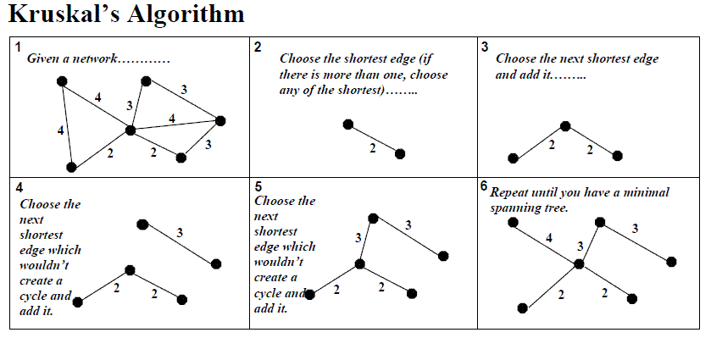

Slide 5
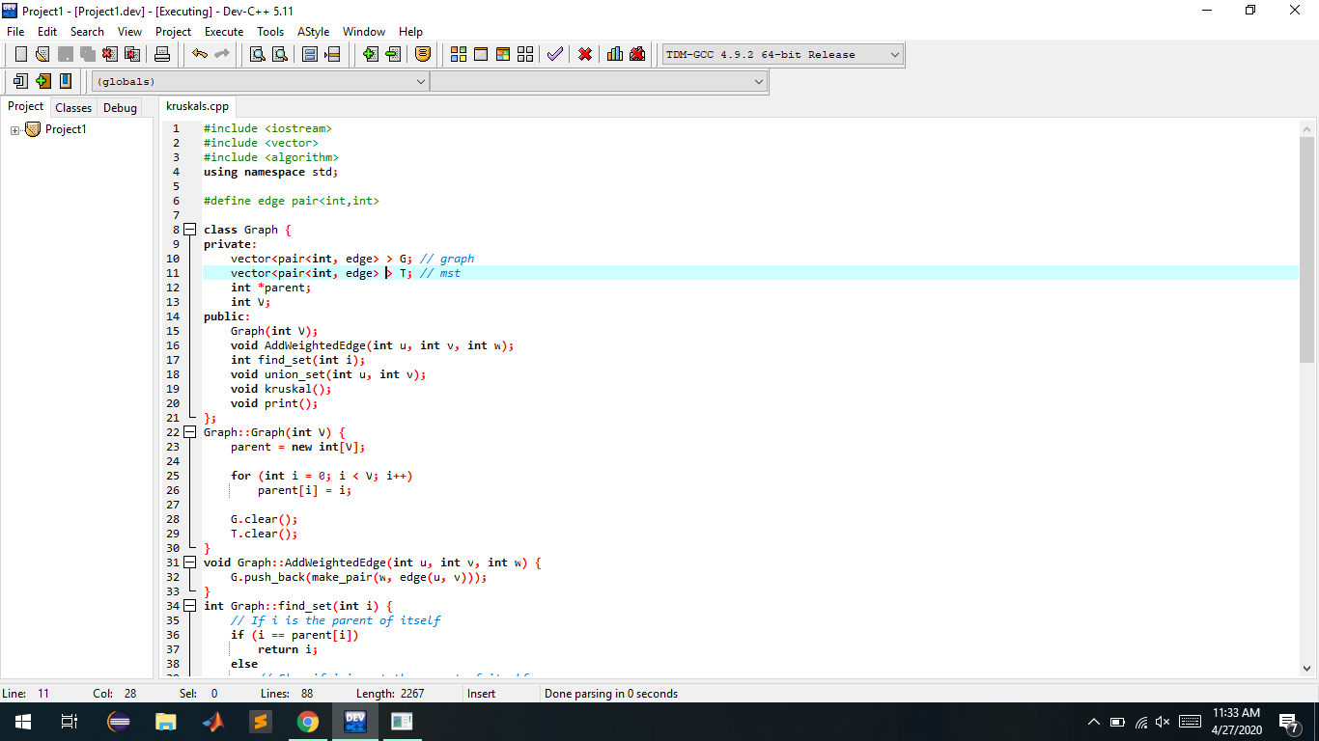
Code-

Slide 6
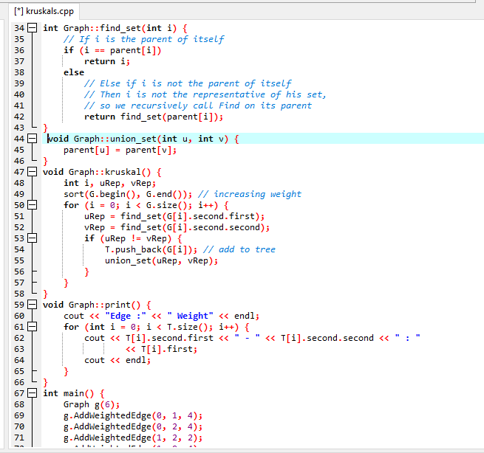

Slide 7
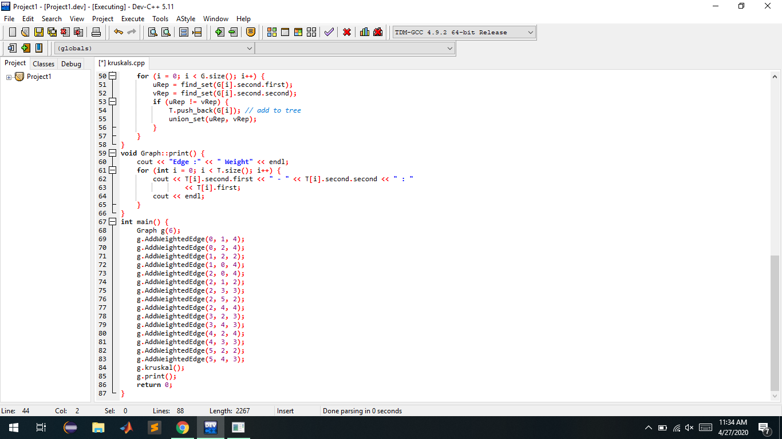

Slide 8
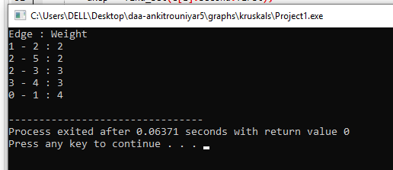
OUTPUT--

